Slide 1

Classes in Java

Slide 2
Class Fundamentals
A class defines a new data type
Once defined, this new type can be used to create objects of that type.
a class is a template for an object, and an object is an instance of a class.
A class is declared by use of the class keyword

Slide 3
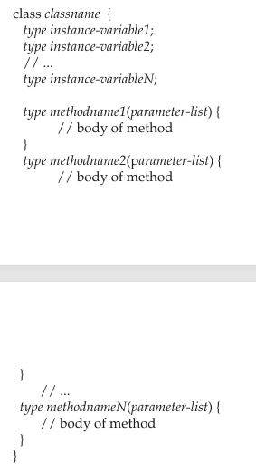
Default Structure of a Class

Slide 4
Class Fundamentals
The data, or variables, defined within a class are called instance variables.
The code is contained within methods.
Collectively, the methods and variables defined within a class are called members of the class.
In most classes, the instance variables are acted upon and accessed by the methods defined for that class
Variables defined within a class are called instance variables because each instance of the class (that is, each object of the class) contains its own copy of these variables
the data for one object is separate and unique from the data for another

Slide 5
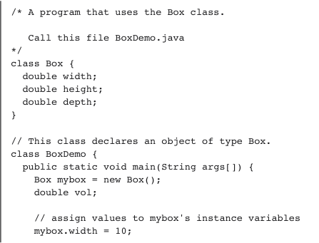
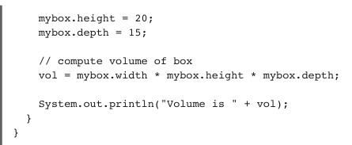

Slide 6
Objects
obtaining objects of a class is a two-step process
declare a variable of the class type. This variable does not define an object. Instead, it is simply a variable that can refer to an object
The new operator dynamically allocates (that is, allocates at run time) memory for an object and returns a reference to it
the address in memory of the object allocated by new.

Slide 7
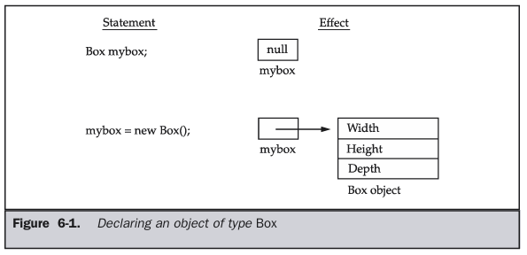

Slide 8
Methods
type name(parameter list)
{
//body of the method
}
type specifies the type of data returned by the method. This can be any valid type, including class types that you create
If the method does not return a value, its return type must be void
The name of the method is specified by name
The parameter-list is a sequence of type and identifier pairs separated by commas. Parameters are essentially variables that receive the value of the arguments passed to the method when it is called.
If the method has no parameters, then the parameter list will be empty

Slide 9
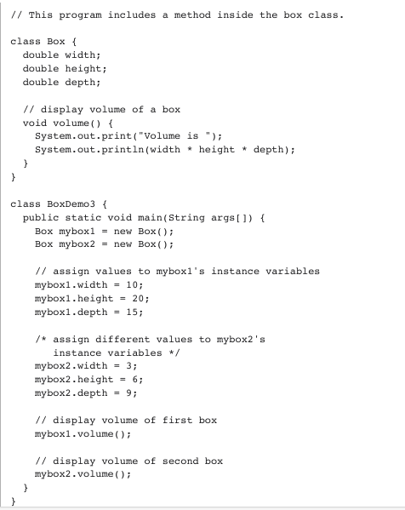




Slide 10
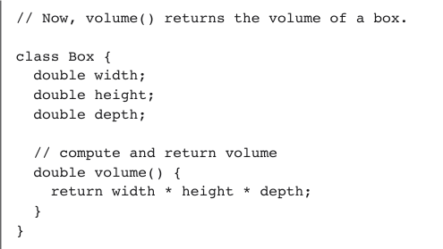

Returning Value

Slide 11
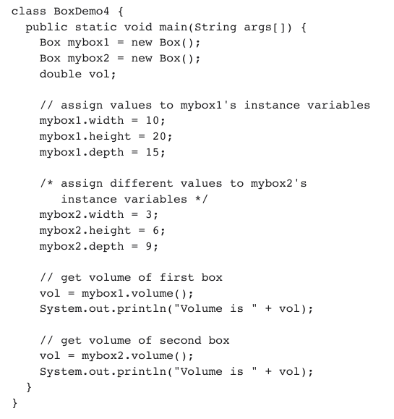

Slide 12
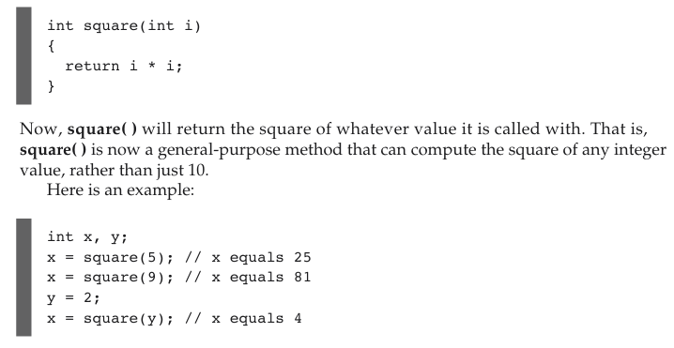
Methods with Parameters

Slide 13
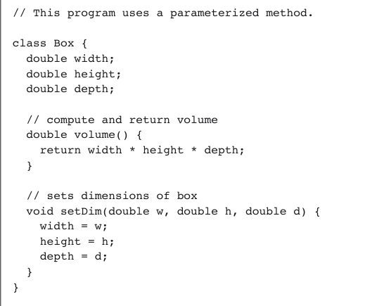
Parameterized method

Slide 14
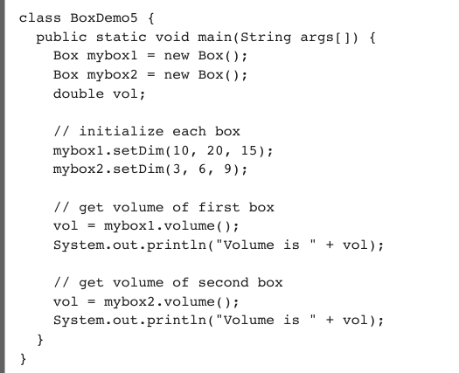

Slide 15
Thank You!!

